Slide 1
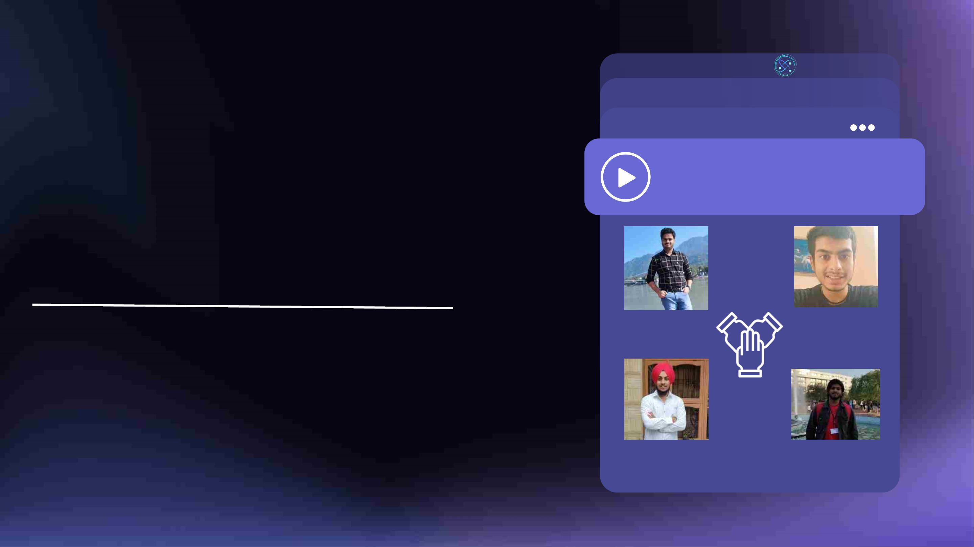
Anti - Vehicle Accident
Detection using Eyes,
Face and Head Gesture
Movements
DEEPGEEKS
OUR TEAM
To counter present day challenges of accidents,
specially in hilly areas, we aim to build an AI
mechanism which inculcates Deep Learning
Algorithms that autonomously detect, prevent
and alert on any possibility of accidents in the
most viable & effective way possible.
Shivam
Yuvraj
Sarthak
Rajveer

Slide 2
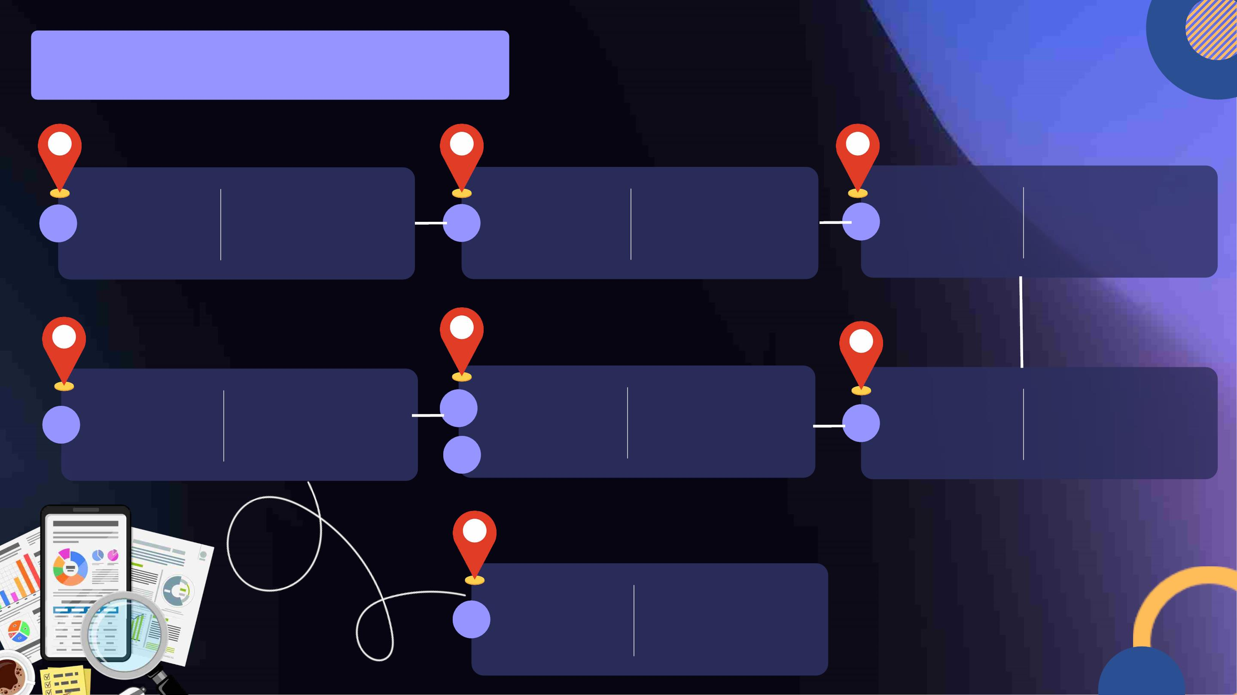
Direction And Roadmap
Getting to know more on
Problem
Statement
Describing the Real-Life
Introduction project we will be working
Solution
Proposed
The ideal solution
required to solve t
concern and addre
issue from its root
issues faced and
explaining how they
impact an indivitual in real
life
And
on and how we faced the
03
01
02
problem and developed
motivation on building the
model.
Motivation
Step-By-
Step
Solution
Describing the Real-Life
issues faced and
explaining how they
impact an indivitual in real
life
Our
Solution
And USP
Providing our solu
concern and provi
appropriate USP's
improvises our mo
differentiates from
Result
Obtained
Showing the outcome of
our project and the
output of our code.
05
05
01
04
Thank
You
Gratitude for giving us
this opportunity to
present our work and
participate in hackathon
at IIT Mandi.
01

Slide 3
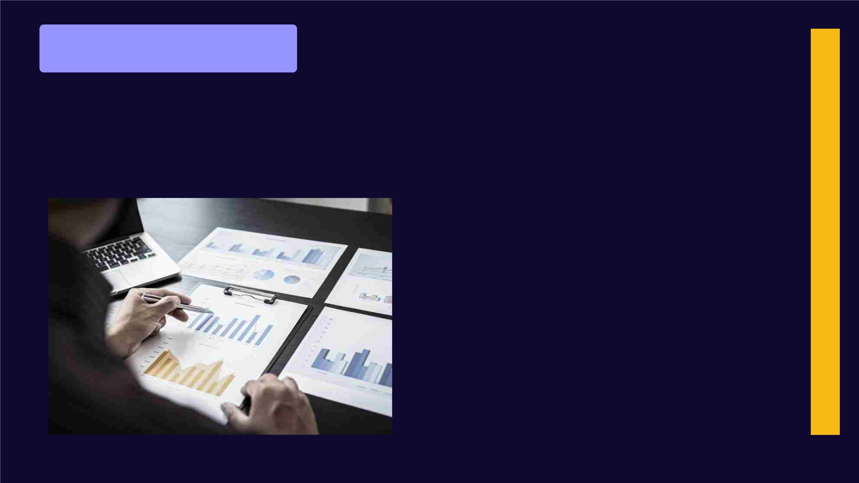
PROBLEM STATEMENT
The issue of driver drowsiness,
distraction, and inattentiveness during
driving poses a significant risk to road
safety. According to the National
Highway Authority of India (NHAI), driver
fatigue and distraction are major factors
in approximately 20% of all fatal car
crashes in India. The need is to monitor
driver behavior and alert them when
signs of fatigue or distraction are
detected. Additionally, the model should
also suggest actions such as rest breaks
or changes in lighting or music to
prevent further distraction which would
improve road safety and save lives.
Why do we
need this App?

Slide 4
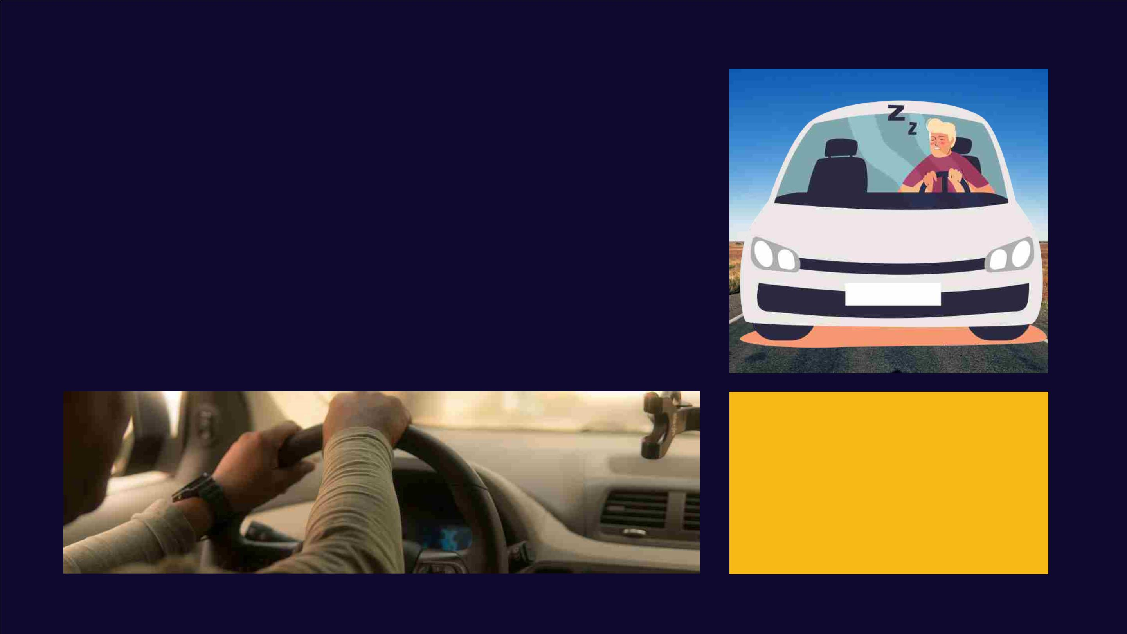
WELCOME WELCOME
Introduction and
Motivation
This Model is based on a Deep Learning Algorithm that
detects , prevents, analyses behaviour and predicts and
alarm the Driver for any potential upcoming accidents
through his facial gestures and head movements.
Coming from Mandi to IIT Mandi at 3
AM, we realised that the driver was
dizzy on the curvy roads of Himachal
Pradesh. This is when we realised the
need of this Application to not only be
easily accessible but also in the most
convenient and inexpensive form.

Slide 5
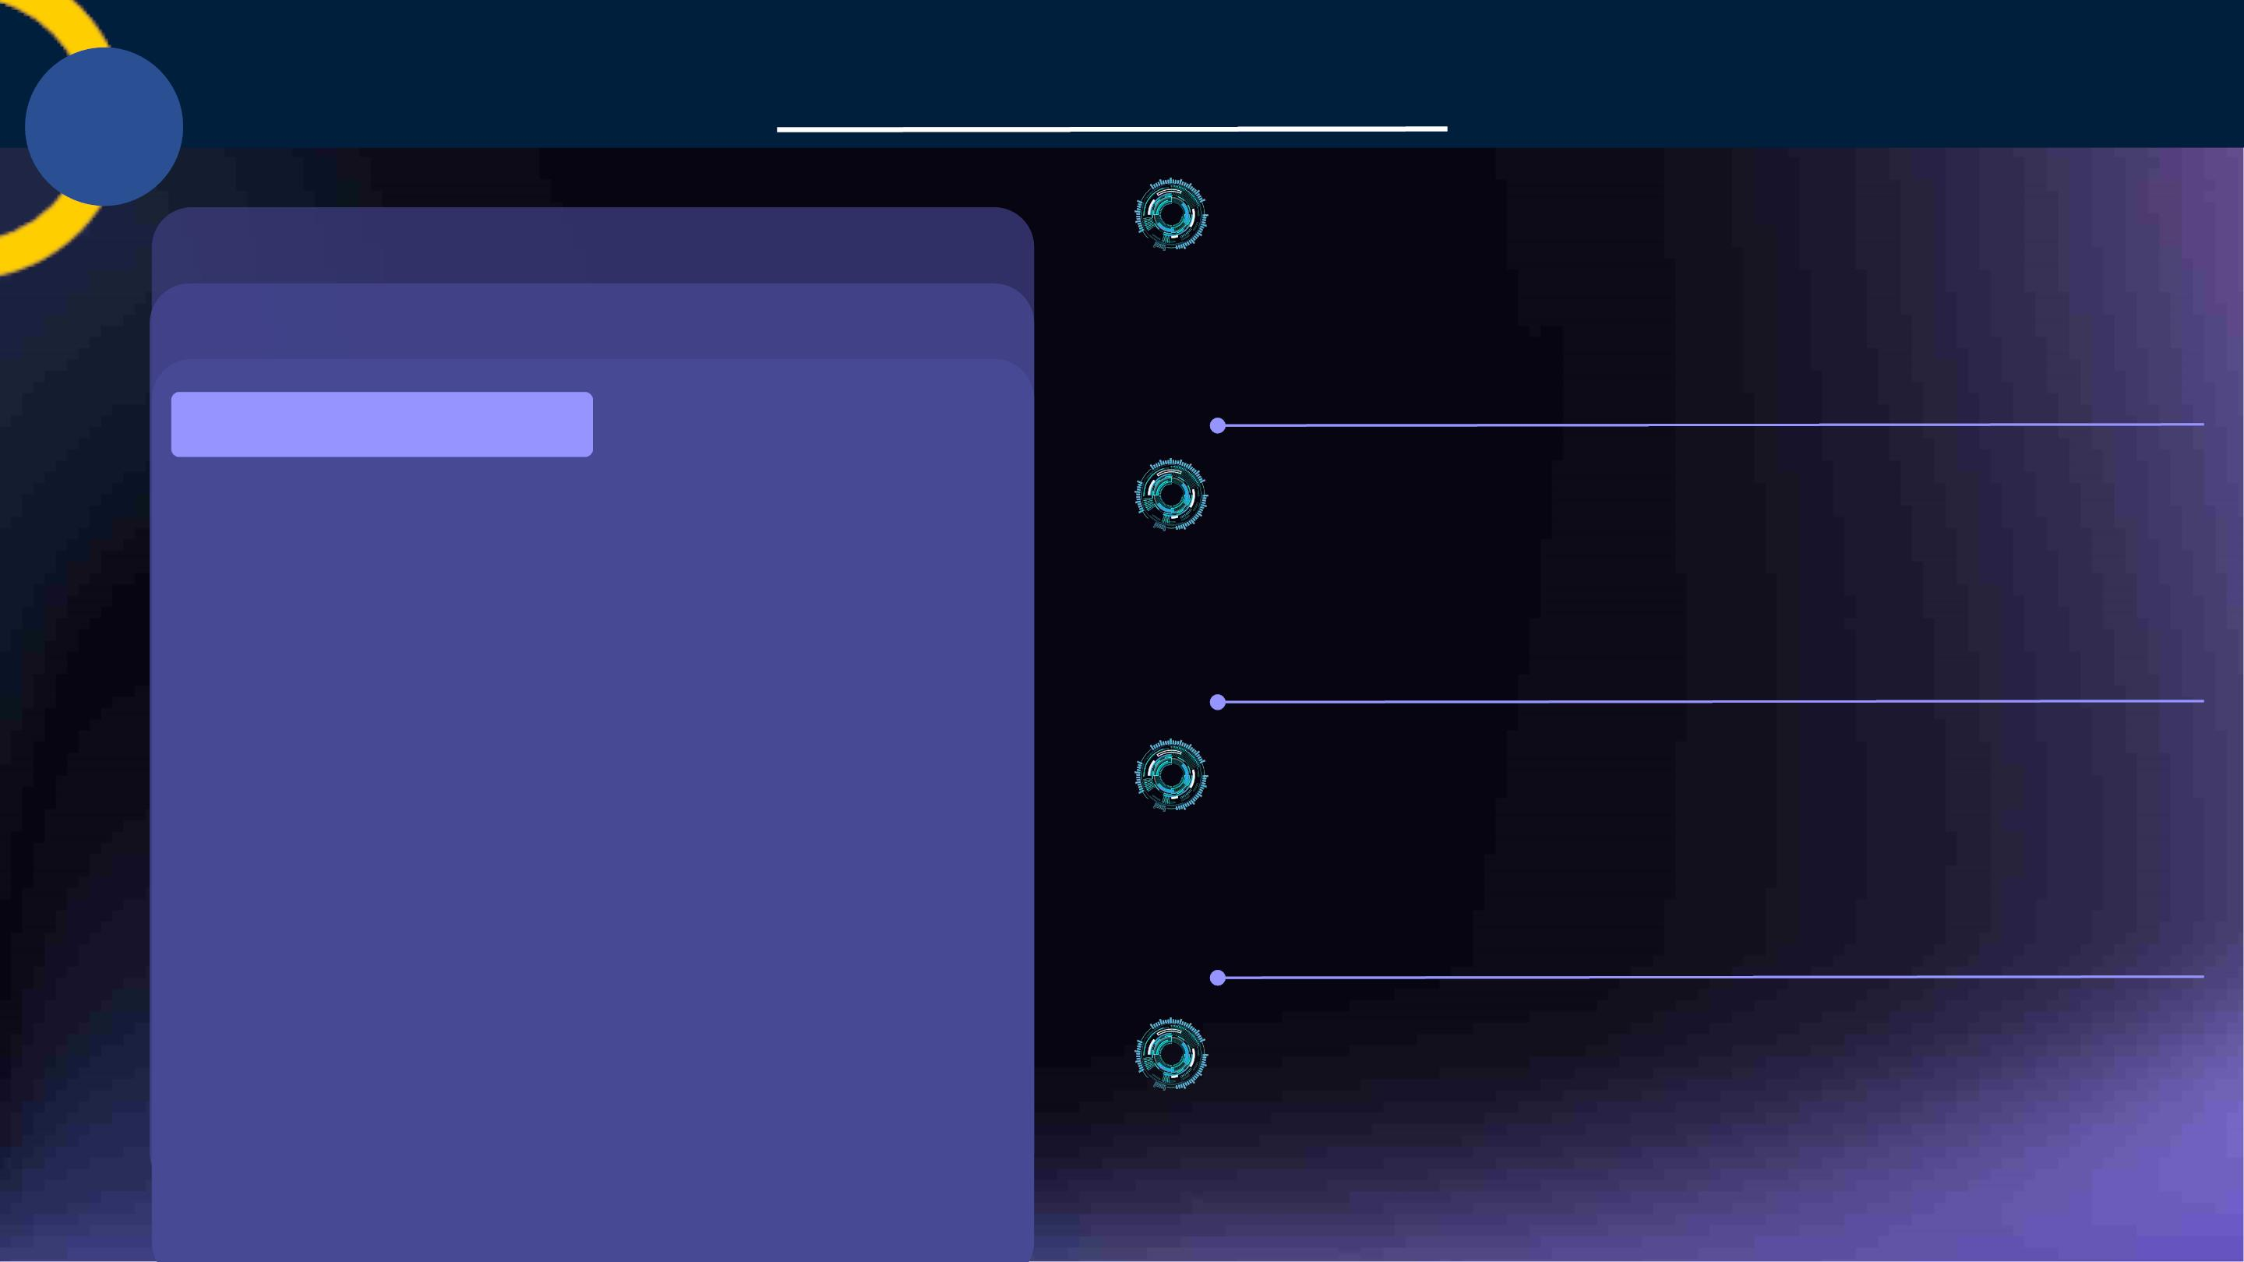
Need of the Hour
KEY FEATURE 01
Web-Application to Monitor & Respond Behavio
using Gesture Movements
App to Monitoring Driver's eye, face and head gesture
and beep alert on any unusual or unsafe practice.
SOLUTIOn Proposed
KEY FEATURE 02
Anti-Vehicle
Accident Detection
Web-App
High Accuracy of Model, offline functionality and
cost of functioning
The model works at ~95% accuracy, without any internet
connectivity and no external instrument required.
KEY FEATURE 03
AI Based Recommendation System to generate pr
users' behaviour.
The Web-App will monitor driver's face,
eyes and head gesture movements to
recognise his behaviour , alert and prompt
on identifying unusual activity such as closed
eyes and send suggestions or emergency
notices as required.
Generating prompt to avoid user from getting distr
or confused such as taking breaks, etc.
KEY FEATURE 04
Emergency Situations and Error Handling
Just like cars, we provide error handling of beep ala
and emergency notification to family in event of
accident or crisis.

Slide 6
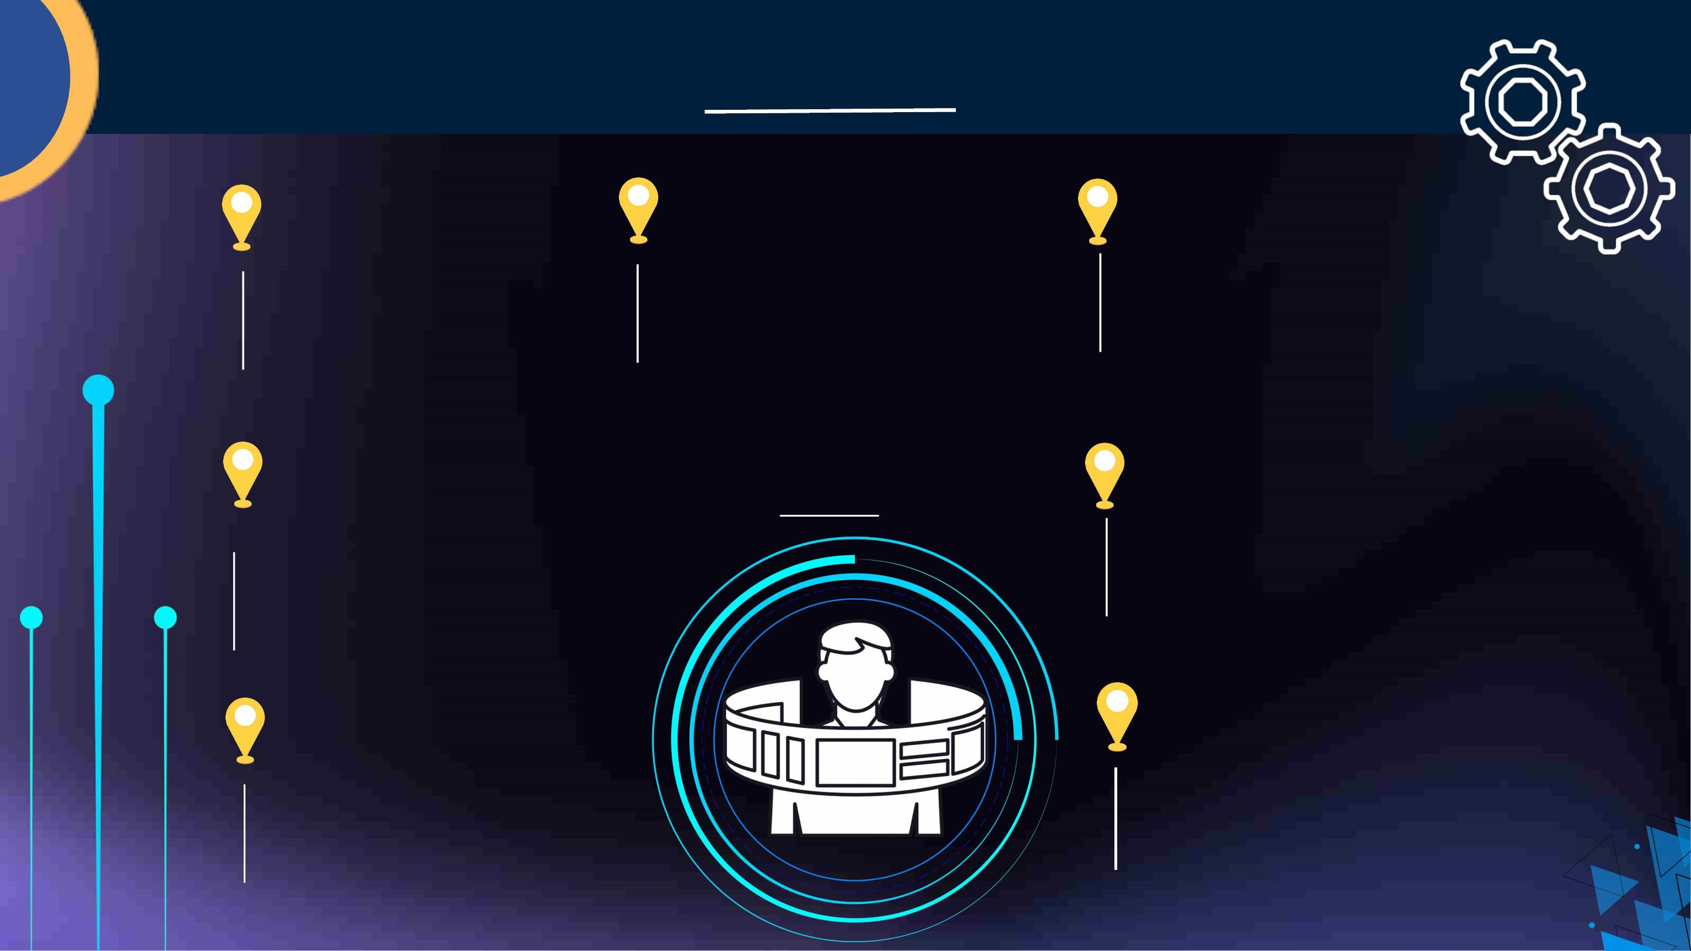
WHY US?
Works Without Internet
even in remote areas
Works even without any
internet connectivity or
network
Exception and Error
Remotely Accessible without
any electronic Sensor
No need of additional
machineries
Handling of resources.
To have manual turn off beap and
accident notification system to family
members in accident or crisis
Our USP
inexpensive and can be
accessed independently
0 cost is required and can be accessed
even by a layman
Application with 95%
Accuracy
Assures to provide one of the
best accuracy of model
available till date.
Beep Alert during unusual
behaviour or gesture
Independent of Steering
Movements
To generate beep alerts during
monitoring if the driver is
unattentive or distracted.
No Need to additionally equip
device on steering for focus on
face.

Slide 7
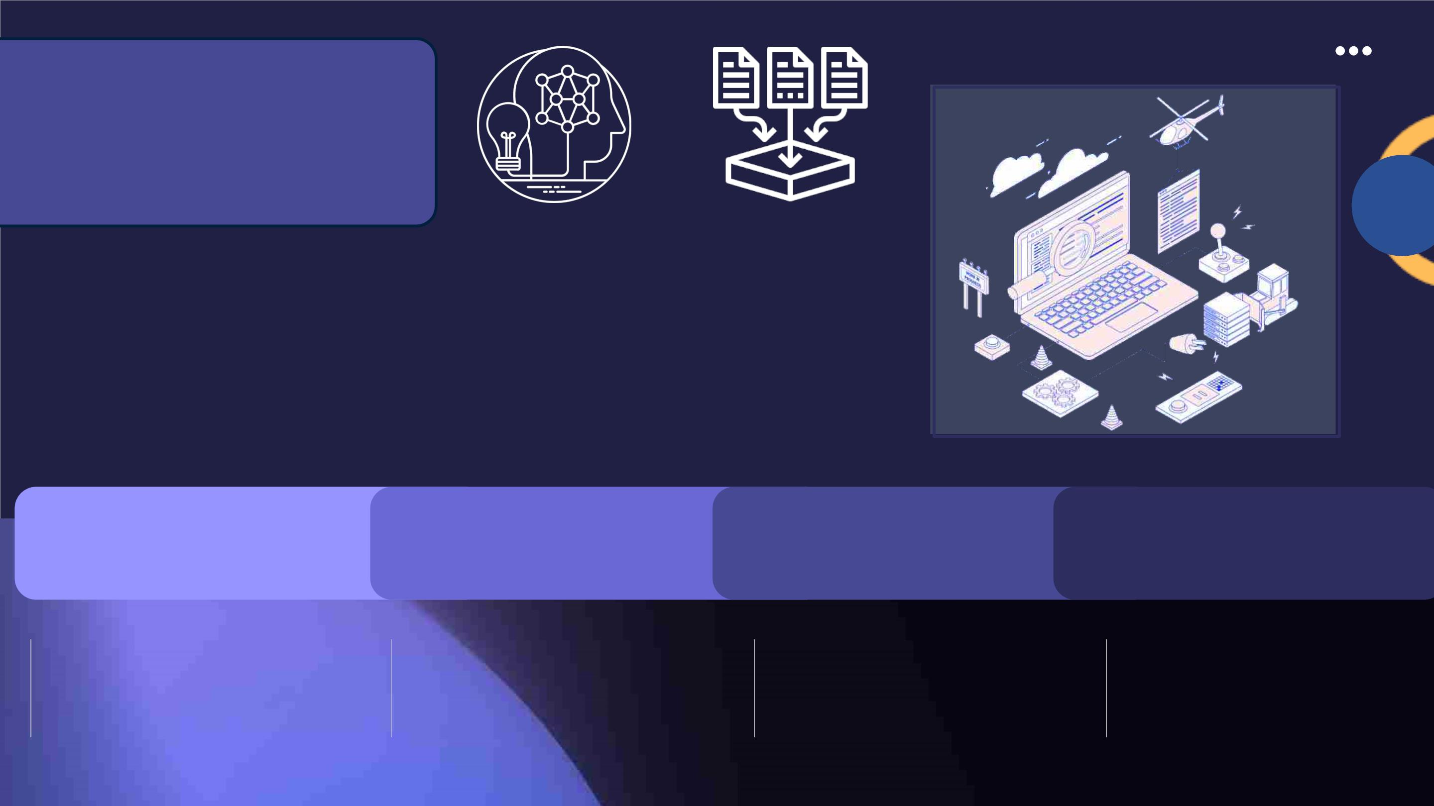
Step-by-Step
Solution
To leverage deep learning, the following four steps are crucial:
collect relevant data, analyze and understand the data, preprocess
it to ensure quality, and finally train and deploy the model. Each
step plays a critical role in ensuring the accuracy and efficiency of
the model, enabling it to make intelligent predictions and
insights.
Step 1: Collection of
data
Step 2: Analysing Step 3: Data Pre -
Step 4: Training
Deplying the Net
the Data
Processing
Our First Step involves
collection and storing of
dataset and then sending it
for processing.
The data will be send to
analytics, where the model will
be accessed and moderated.
This is done to reduce noise as
well.
Data-Prepossessing will make
it ready to send for training
and refining, and will be
Data will be trained a
deployed and the pro
will repeat until a goo
accuracy is achieved.
repeated for better accuracy.

Slide 8
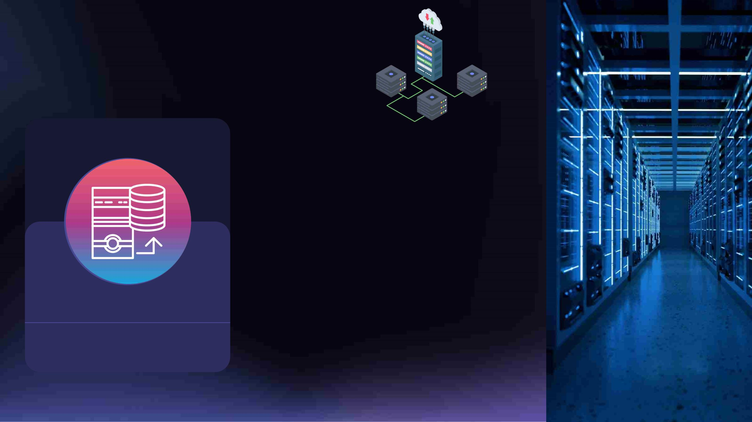
STEP 1: Collection of
Data
MRL EYE DATASET
The data which we use
for this project is MRL
eye dataset which
contains infrared images
of human eye in low and
high resolution all
Gathering and Storage of Data
captured in various
lighting conditons.
Dataset is broadly collected and
stored for upcoming use in the
Deep Learning models.

Slide 9
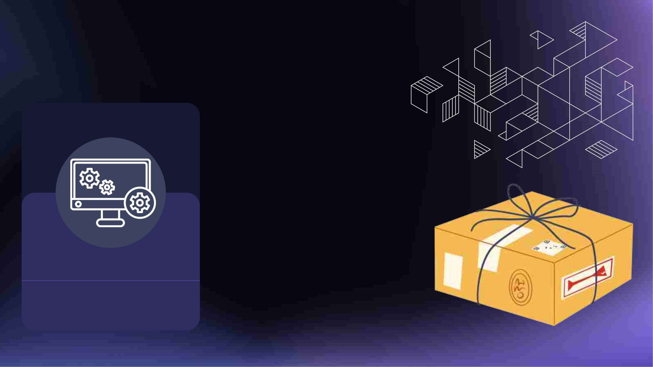
Packages and Software
Used
• Jupyter notebook
RESOURCES USED
• Pandas, numpy
• Matplotlib,seaborn
• Os, shutil
• tensorflow,keras
• Skiimage,OpenCv
• Webcam/mobile phone
cameras
• Mixer , Alarm.wav file
• Heroku
• Docker
Gathering and Storage of Data
Dataset is broadly collected and stored
for upcoming use in the Deep Learning
models.
• HTML,CSS, Javascript
• Anaconda navigator
• Git, github, git CLA

Slide 10
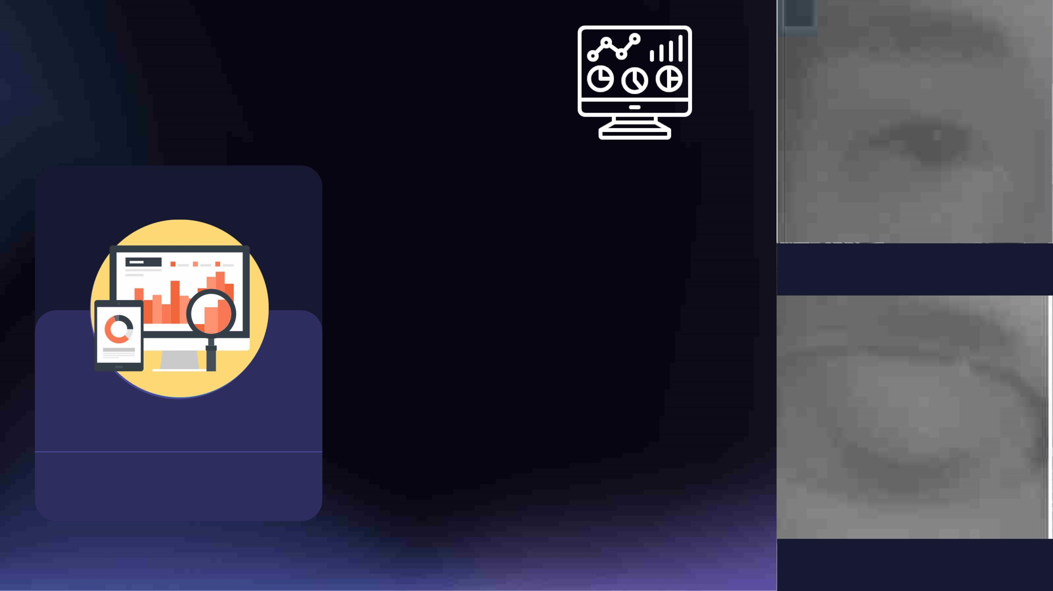
STEP 2: Analyzing the
Data
PYTHON LIBRARIES
After getting our dataset our next
step will be to analyze the dataset so
we can do data processing and
feature engineering efficiently.
During the analysis we will focus on
the answers of below mentioned
questions:
OPEN EYE
Analyzing the Data
• Shape of dataset
• Various Columns present in the
Dataset Labelling of distribution
• Type of image (RGB or grayscale)
Dimension of the image
Analysing the stored data to process
and feature engineering. This is done
to study more on the dataset used.
CLOSED EY

Slide 11
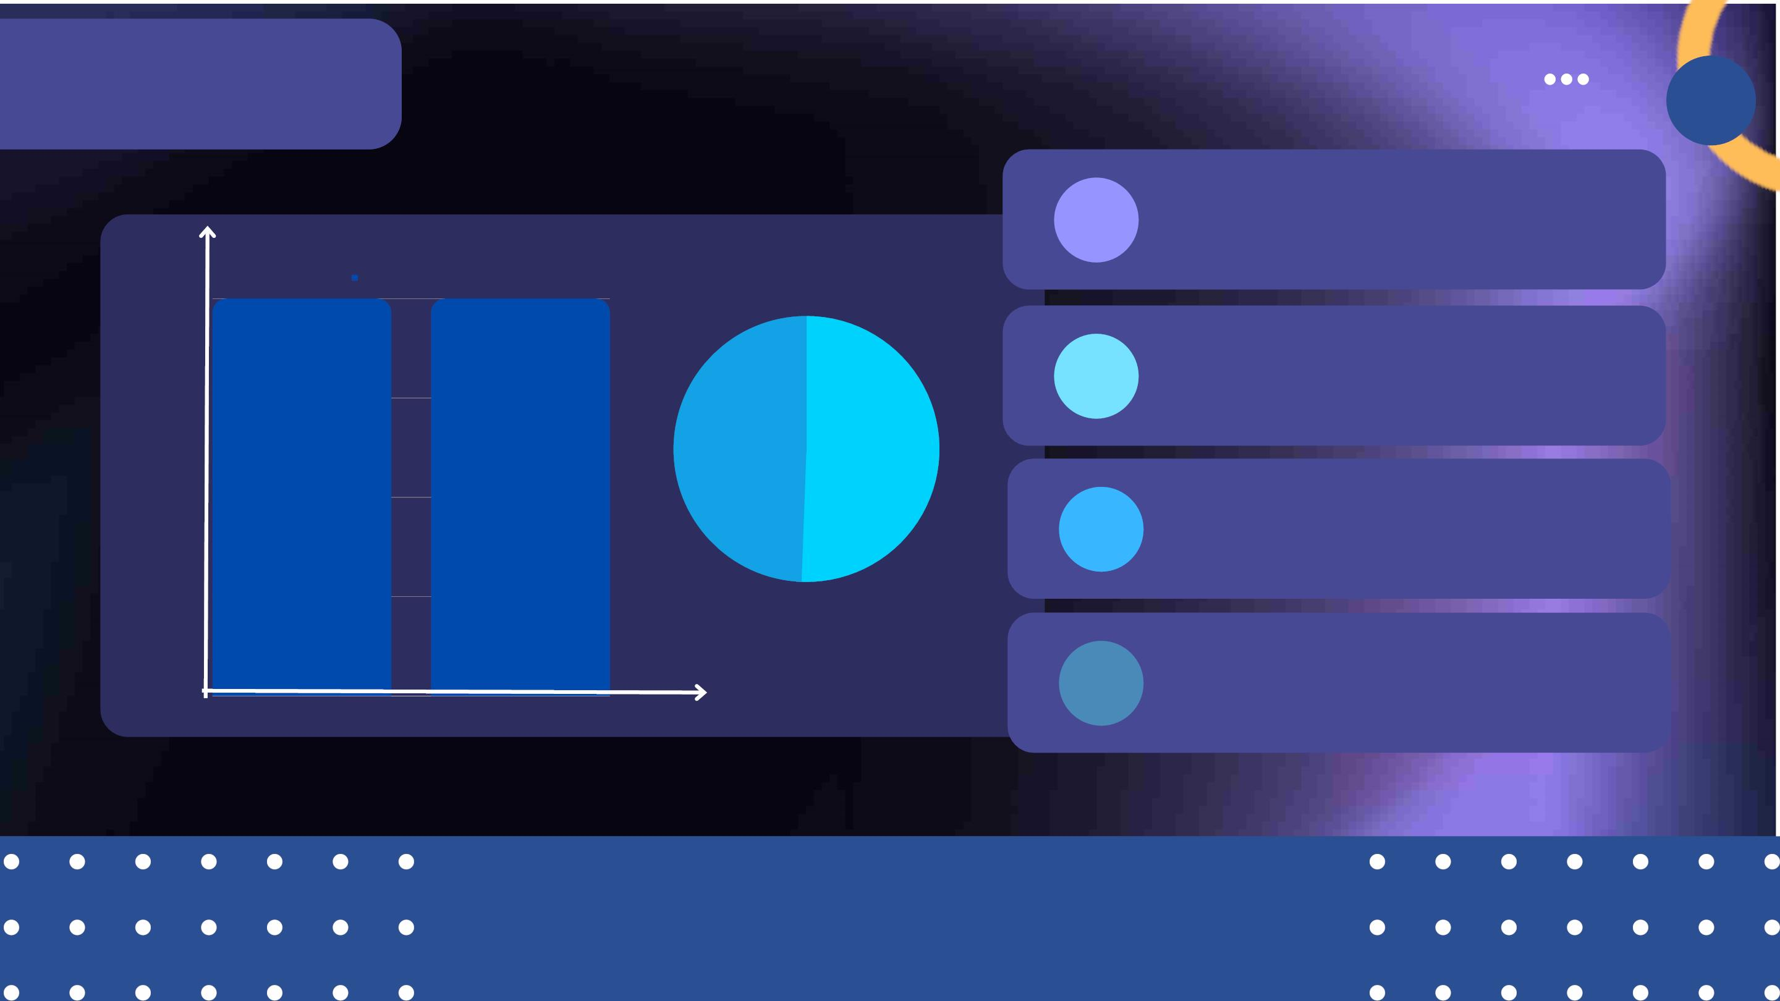
Report After EDA
1
2
76,000 images
Open/Close
4,000ꢀ
3,000ꢀ
2,000ꢀ
1,000ꢀ
8 different columns
0
1
49.4%
50.6%
3 37,000 closed and 39,000
open eye image
4
Gray scale images
0ꢀ
0
1
Reports successfully matched with ~ 95
percent accuracy.

Slide 12
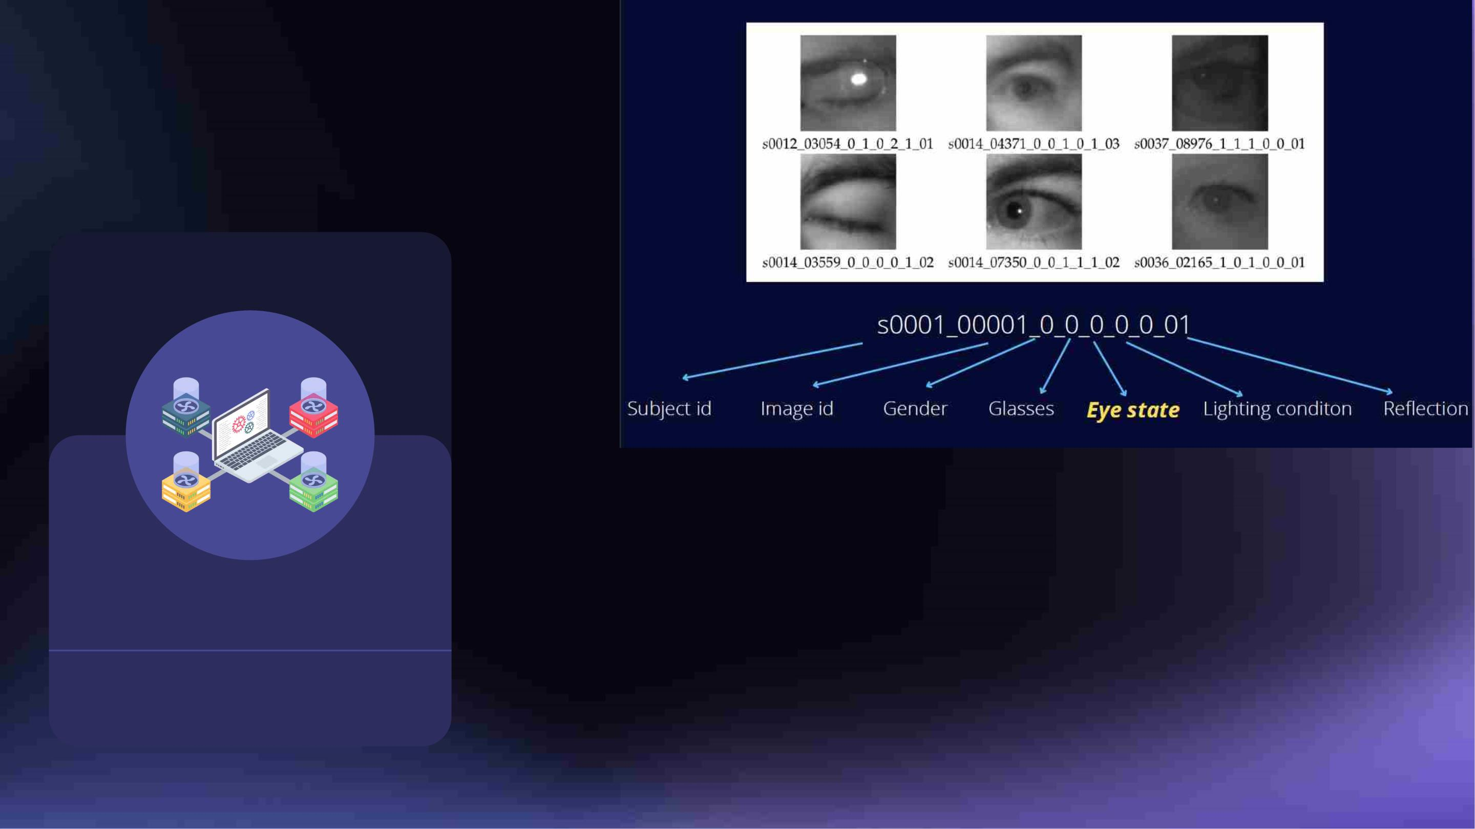
STEP 3: Data Pre -
Processing
OPERATIONS ON DATA
Dropping the unnecessary columns from
the dataset Separating images into open
and closed eyes Creation of more data us
data augmentation Dividing the data into
train ,test and validation data.
Data is Pre-Processed before
algorithms are performed.
Data is mainly send to be prepared
for deep learning algorithms and
operations at this stage.

Slide 13
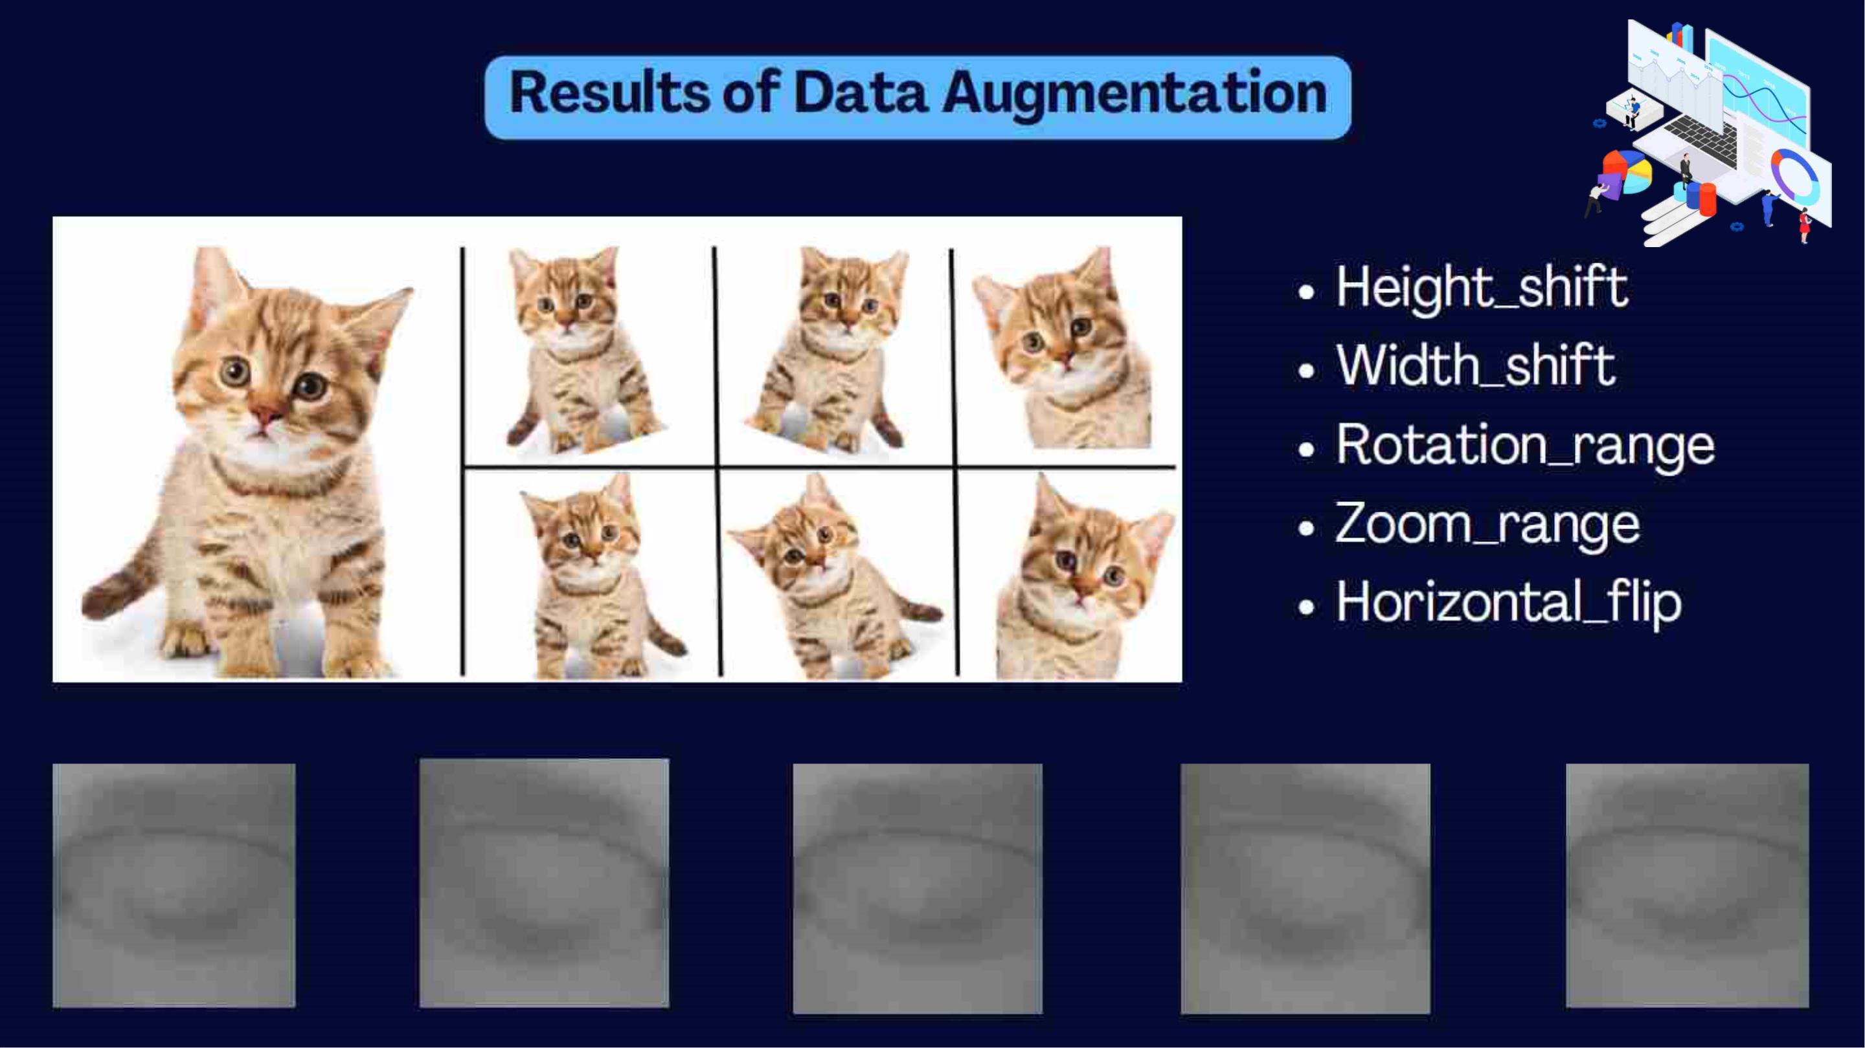

Slide 14
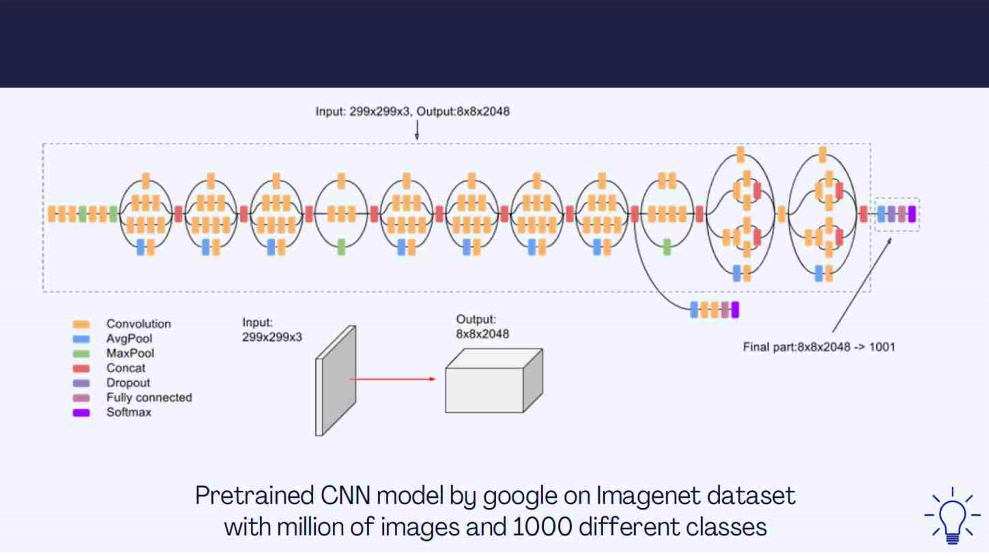
Training Pretrained InceptionV3 CNN model

Slide 15
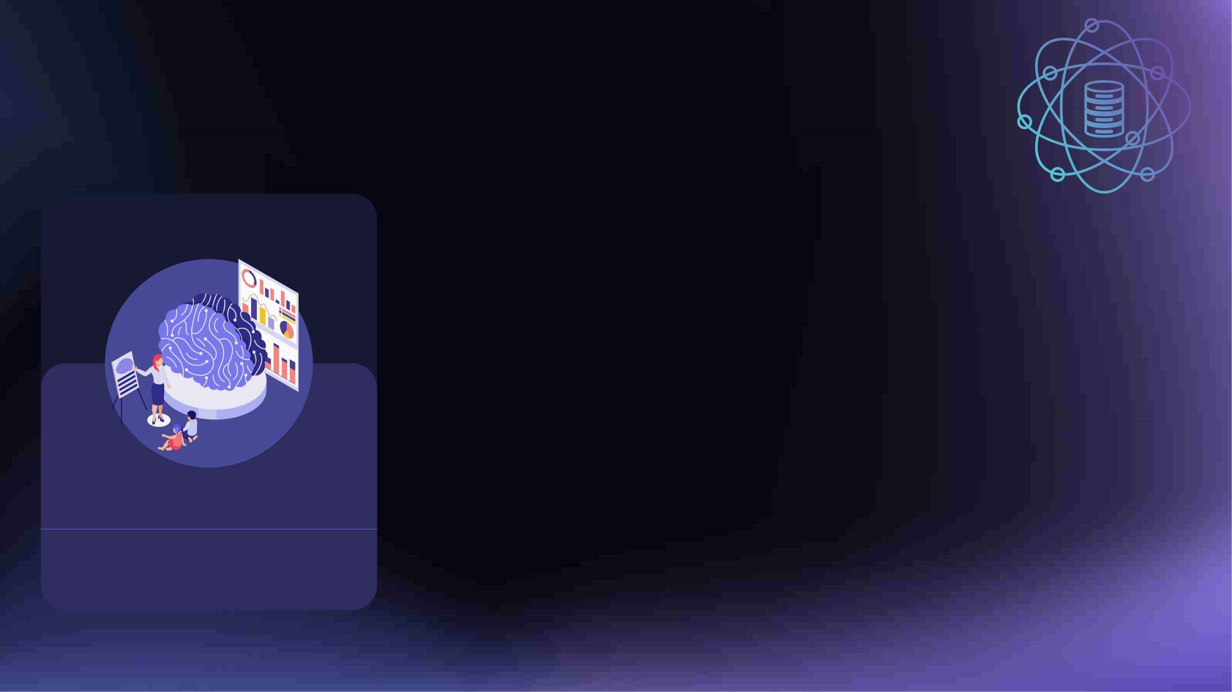
STEP 4: Training &
Deployment of network
DEEP LEARNING & AI
For the training our deep learning
architecture we will focus on CNN model
and also we will try to combine some pre-
trained CNN models for achieving better
accuracy. Regarding the pre-trained
models we will focus on YOLO,
Gathering and Storage of Data
InceptionV3, RetinaNet , Mobilenet, VGG19
and Resnet CNN architectures.
Dataset is broadly collected and
stored for upcoming use in the
Deep Learning models.

Slide 16
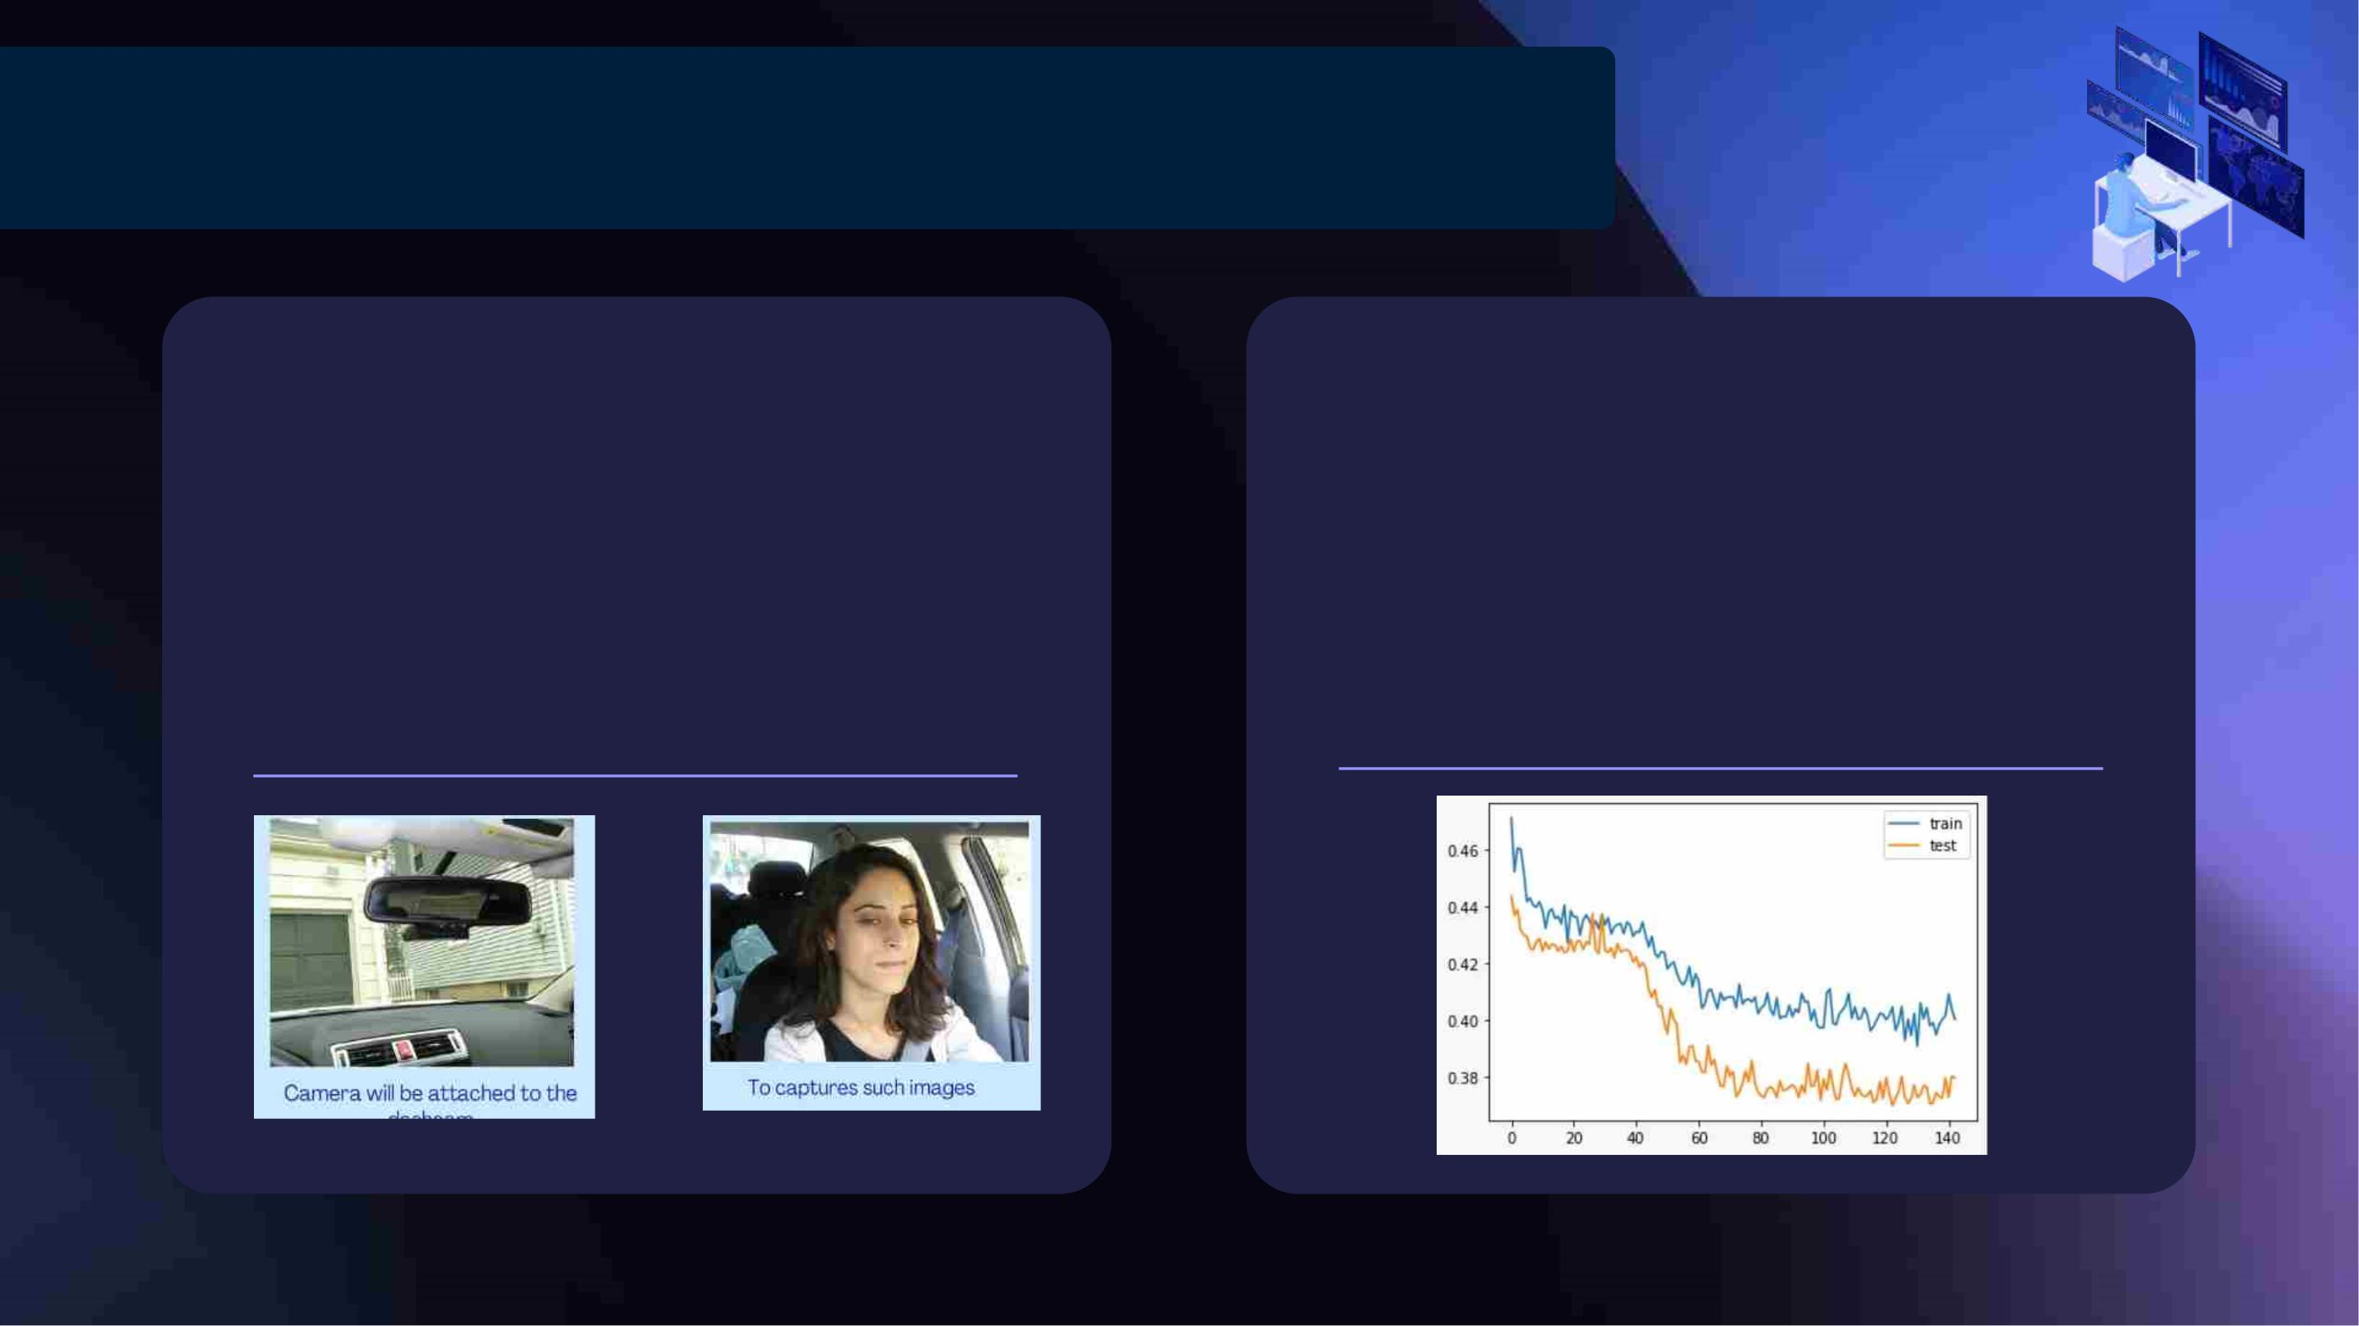
Expected Output And Calculated Output
Expected Output
Calculated Output
We expect an output that can
This process ensures that our model is
on the right track and our measures of
accuracy are up-to the mark. The output
also validates our progress in front of
accuracy obtained
successfully analyse, predict, notify
and alarm the driver based on his/her
behavioural changes in gestures.

Slide 17

And Here Comes...
The Final Output

Slide 18
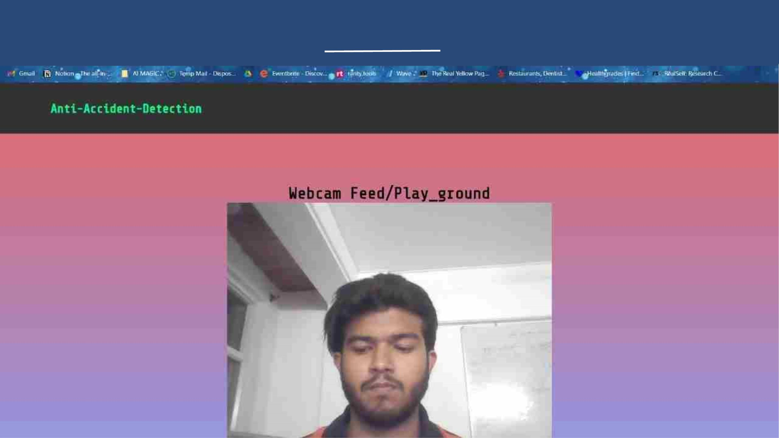
A Glimpse of the Web -Application

Slide 19
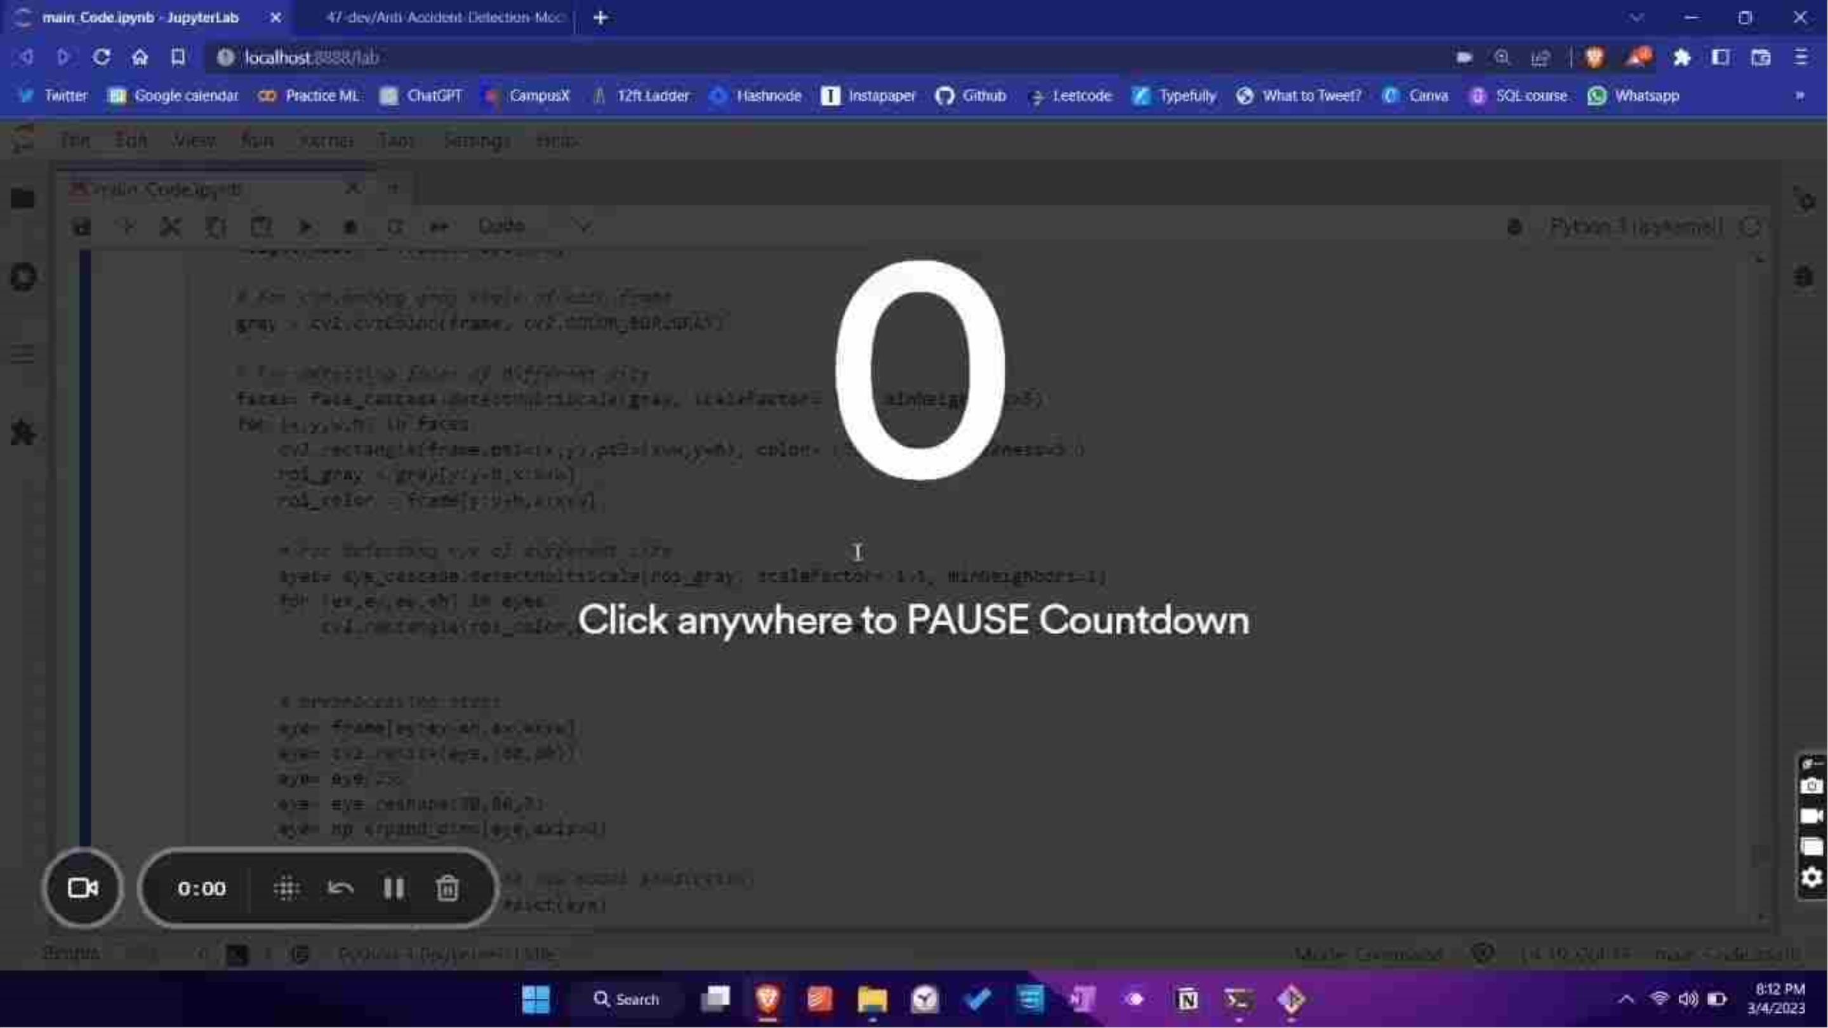

Slide 20
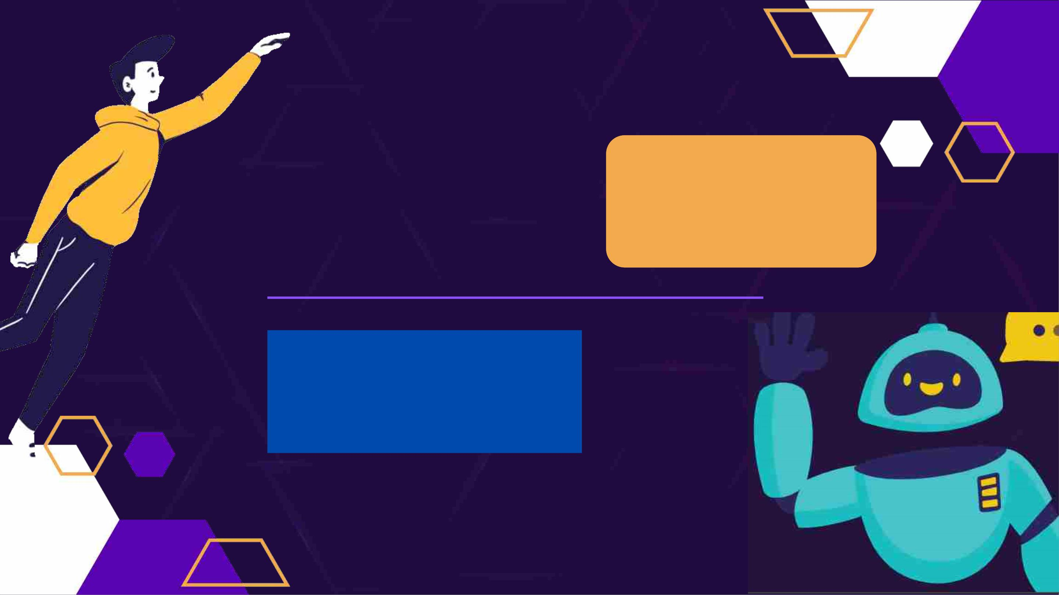
THANK YOU
We are grateful to present our
project for this hackathon and
expect your valuable feedback to
inculcate in our value standards

